Slide 1
Group ID : 12
Chapter 1 :- Introduction
1.1 :- Organization Profile
1.2 :- System Details
1.2.1 :- Existing System
1.2.2 :- Proposed System
1.3 :- Scope of System
1.4 :- Objectives

Slide 2

1.1 : Company Profile
Company Name : Tech Crave Solutions(OPC) Pvt Ltd
Company Address : Ahmedabad , Gujarat-382470.
Specialities : Mobile application, Website, Web services.
Founded : April , 2021 .
Contact : +919377630883
E-mail : vishaltanna.professional@gmail.com

Slide 3
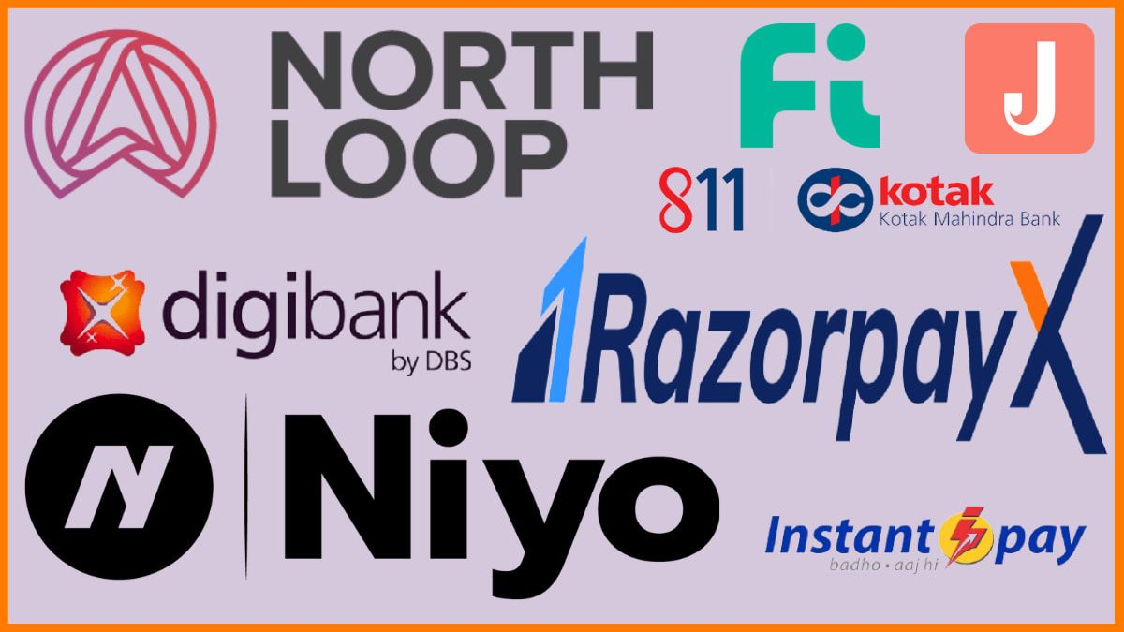
1.2 : System Details
1.2.1 : Existing System :
Traditional banks, while serving as essential pillars of the financial system for centuries, have faced various challenges and problems over time.
High Operating Costs : - Traditional banks often have significant
overhead costs associated with maintaining physical branches,
staffing, and administrative expenses.
Limited Accessibility : - Physical branches have limited hours of
operation and may not be easily accessible to all customers,
especially those in rural or remote areas.
Regulatory Compliance Burden : - Traditional banks are subject to a complex web of regulations, which can result in compliance costs.
There are many Neo Banks are working in India such as Jupiter Bank, Fi Money, Freo, InstantPay, FamPay, RazorpayX etc.

Slide 4
1.2.2 : Proposed System :
A new type of bank called a Neo Bank is coming into the banking world. It wants to change how banking works, making it easier and more helpful for anyone.
With our Neo Bank, we aim to break free from the constraints of traditional banking. Say goodbye to long queues at branches, complex paperwork, and hidden fees.
We're here to provide you with a hassle-free, transparent, and accessible banking experience.
Promises to eliminate traditional constraints:
Long queues at branches.
Complex paperwork.
Hidden fees
The Neo bank system is a revolutionary approach to banking that has changed the traditional financial approach.
Unlike traditional banks with physical branches, Neo banks are fully digital financial institutions that operate exclusively through web and mobile applications.

Slide 5
1.3 :Scope of the System
Our System typically offers a limited range of products and services, such as savings accounts, checking accounts, debit cards, and loans. However, they focus on providing these products and services in a way that is easy to use and accessible to everyone.
We are an online-only bank using technology to offer users a convenient, affordable, and personalized banking experience.
Communicate with potential customers 24/7. We work hard to understand what people today want and need from a bank. We also come up with cool and unique ways to help with money stuff, and they let you customize your banking experience.
Customer can view their account online. Customer can also make payment online.
Neo banks are still a relatively new phenomenon, but they are growing rapidly. The global neo bank market is expected to reach $333.4 billion by 2026. This growth is being driven by the increasing popularity of digital banking, as well as the growing demand for more convenient, affordable, and personalized financial services.

Slide 6
1.4 : Objectives of System
Digital Convenience: Neo banks aim to provide a seamless and user-friendly digital banking experience, allowing customers to open accounts, conduct transactions, and manage their finances entirely through mobile apps or web platforms.
Financial Inclusion: Many neo banks target underserved or unbanked populations, seeking to provide accessible and affordable banking services to individuals who may have limited access to traditional banking options.
Fast and Easy Account Opening: Neo banks strive to simplify the account opening process, making it quick and straightforward for customers to sign up and start using their services.
Enhanced Customer Experience: Providing excellent customer service and support is a key objective for neo banks, as they seek to differentiate themselves from traditional banks and foster strong relationships with their customers.
Continuous Improvement and Innovation: Neo banks prioritize continuous improvement and innovation to stay at the forefront of technology and offer cutting-edge banking solutions.

Slide 7
Financial Education: Some neo banks focuses on educating customers about financial matters. Their objectives are to promote financial literacy and empower customers to make decision about their money.
Paperless and Eco-Friendly Approach: Neo banks often emphasize a paperless and eco-friendly approach to reduce their environmental impact. Their objective is to conduct all banking processes digitally, from account opening to transaction records.
AI-Powered Customer Support: Neo banks may use artificial intelligence to enhance customer support and provide prompt assistance. Their objective is to resolve customer queries efficiently and offer a personalized support experience.
Loan and EMI :- In a Neo banking system, loans and EMIs (Equated Monthly Installments) are typically offered as part of their suite of financial products.
Loan Offers :-
Business Loan
Special loan on Goods

